Slide 1
SQL Data Analyst Project
Hariom S. Theng

Slide 2
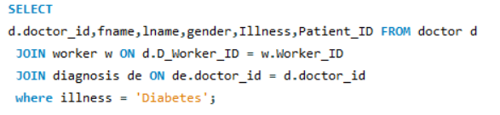
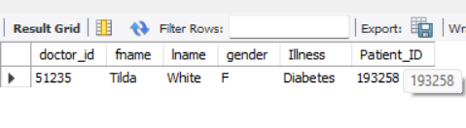
#1. Find all the docotrs who have treated a patient for 'Diabetes'

Slide 3
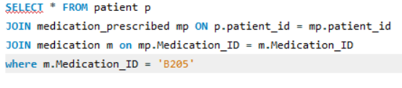
#2. List the details of all patients who have been prescribed "B205."

Slide 4
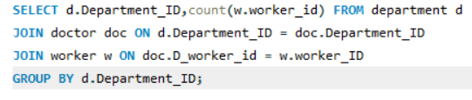
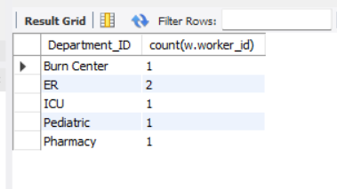
#3.Find the total number of workers in each department.

Slide 5
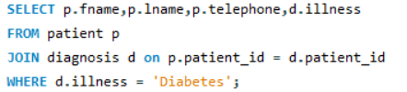
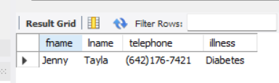
#4. Retrieve the names and phone numbers of all patients who have been diagnosed with "Diabetes."

Slide 6
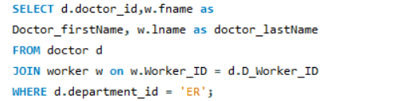
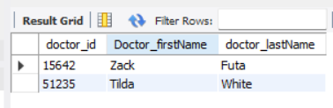
#5. Get the names and IDs of all doctors who work in the "ER" department.

Slide 7


#6. Find the total salary expenditure for all workers.

Slide 8
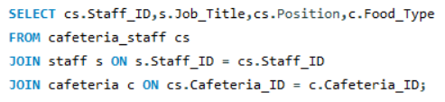

#7. List all cafeteria staff along with their job position and the food type served in their assigned cafeteria.

Slide 9

#8.Show details of patients along with the medication they are prescribed, even if no medication has been prescribed.

Slide 10

#10.Find the average age of patients diagnosed with "Flu."

